Slide 1
Empirical Evaluation of Gated Recurrent Neural Networks on Sequence Modeling
By: Talha Altaf K67896
Jaiki K67913

Slide 2
Abstract
In this paper we compare different types of recurrent units in recurrent neural networks (RNNs).
Long short-term memory (LSTM)
Gated recurrent unit (GRU)
We are using three dataset of polyphonic music and speech signal.

Slide 3
Background: Recurrent Neural Network
Why we actually need RNN?

Slide 4
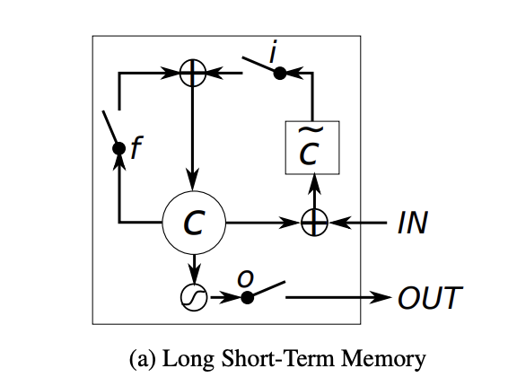
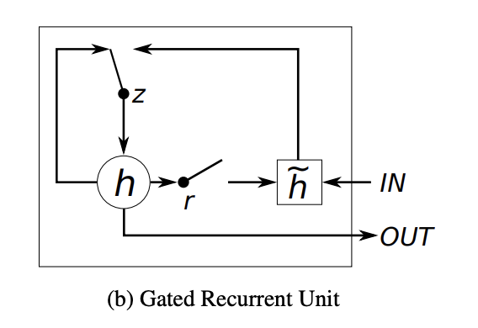
Recurrent Units
Long Short Term Memory
Forget Gate
Input Gate
Output Gate
Gated Recurrent Unit (GRU)
Update Gate
Reset Gate

Slide 5
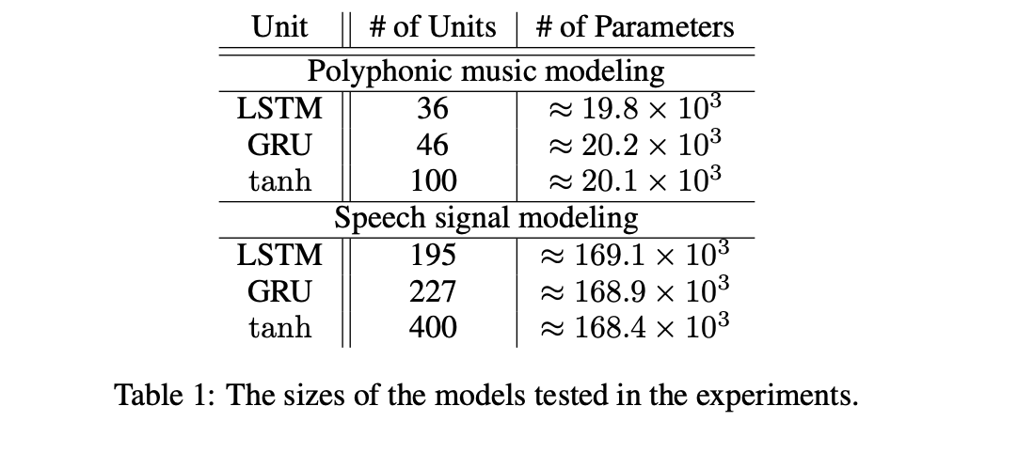
Models

Slide 6
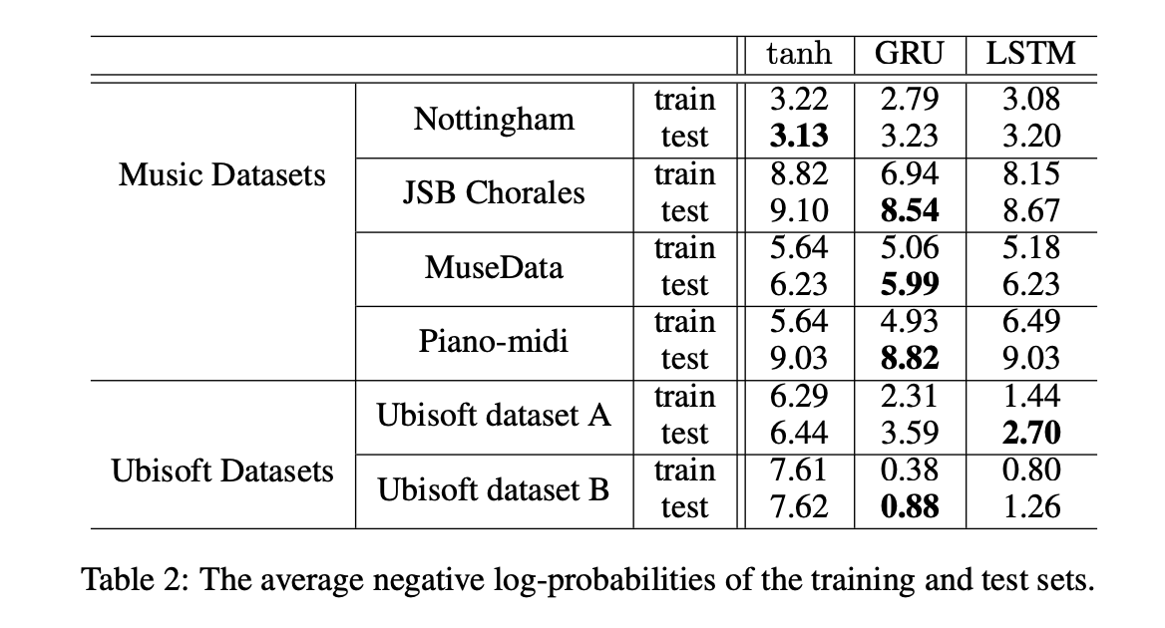
Results and Analysis

Slide 7
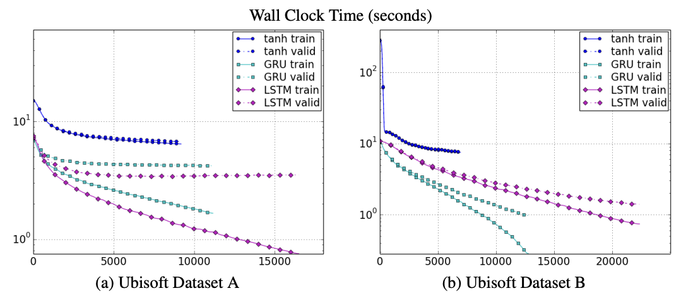
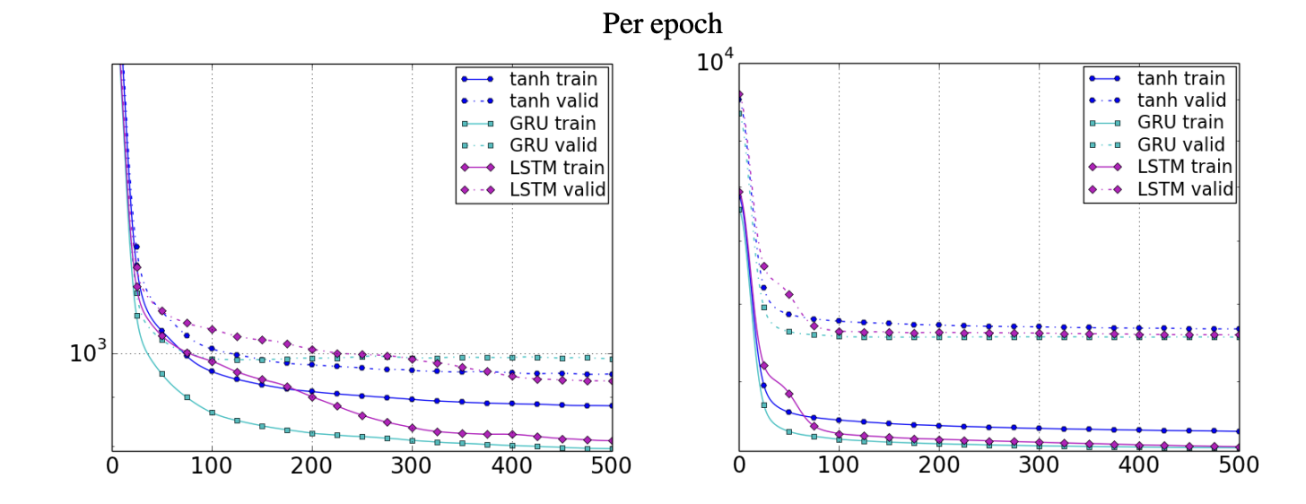
Results and Analysis
Speech Signal Dataset
Polyphonic Music Dataset

Slide 8
Conclusion
LSTM and GRU is better than the normal tanh units.
We cannot definitively say that LSTM is better than GRU, as their performance depends entirely on the dataset.

